Slide 1
Robustness of Coevolved Strategies in a Real-Time Strategy Game
Authors: Christopher Ballinger, Sushil Louis
caballinger@cse.unr.edu, sushil@cse.unr.edu
http://www.cse.unr.edu/~caballinger

Slide 2
Outline
RTS Games
WaterCraft
Motivation
Prior Work
Methodology
Representation
Encoding
AI Behavior
Performance Metrics
Score
Baselines
Genetic Algorithm
Coevolution
Results
Conclusions and Future Work

Slide 3
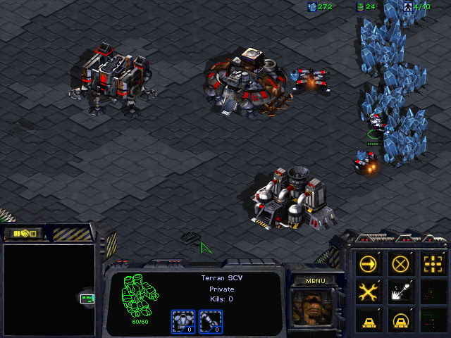
Real-Time Strategy
RTS games:
Manage economy
To build army
Many types of units
Each type has strengths and weaknesses
Getting the right mix is key
Research upgrades/abilities
To destroy enemy

Slide 4
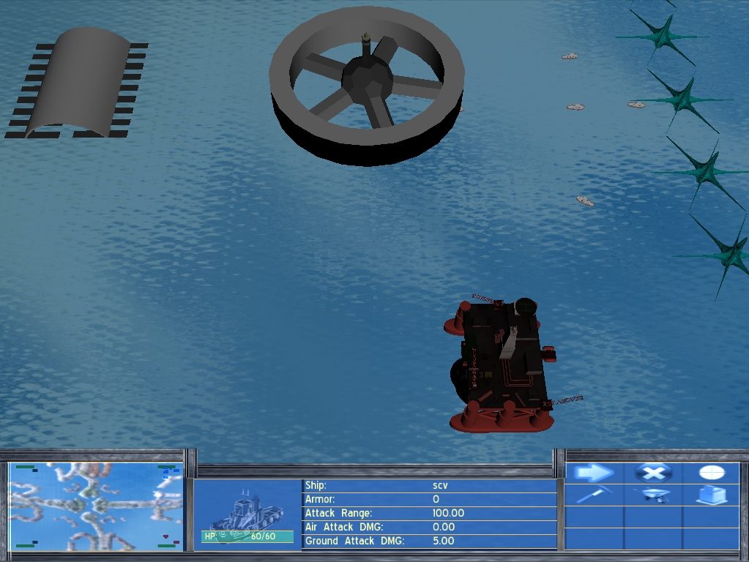
WaterCraft
WaterCraft†
Modeled after StarCraft
Easy to run in parallel
Runs quicker by disabling graphics
† Source code can be found on Christopher Ballinger’s website

Slide 5
Motivation
RTS games are good testbeds for AI research
Present many challenging aspects
Intransitive relationships between strategies, similar to rock-paper-scissors
Robustness of strategies
We believe designing a good RTS game player will advance AI research significantly (like chess and checkers did)
S1
S3
S2

Slide 6
Previous Work
Case-based reasoning (Ontanion, 2006)
Genetic Algorithms + Case-based Reasoning (Miles, 2005)
Reinforcement Learning (Spronck, 2007)
Studies on specific aspects
Combat (Churchill, 2012)
Economy (Chan, 2007)
Coordination (Keaveney, 2011)
What we do
Focus on build-orders
Robustness against multiple opponents
Compare two methods
Genetic Algorithm (GA)
Coevolutionary Algorithm (CA)

Slide 7
Representation - Encoding
Bitstring
3-bits per action
39-bits(13 actions) total
Decoded sequentially
Inserts required prerequisites
Bit Sequence | Action | Prereq.
000-001 | Build SCV (Minerals) | None
010 | Build Marine | Barracks
011-100 | Build Firebat | Barracks, Refinery, Academy
101 | Build Vulture | Barracks, Refinery, Factory
110 | Build SCV (Gas) | Refinery
111 | Attack | None

Slide 8
Representation - AI Behavior
Execute actions in the queue as quickly as possible
Do not skip ahead in the queue
“Attack” action
All Marines, Firebats, and Vultures move to attack opponents Command Center
Attack any other opponent units/buildings along the way
If nearby ally-unit is attacked, assist it by attacking opponent’s unit
If Command Center is attacked, send SCVs to defend
Once all threats have been eliminated, SCVs return to their tasks

Slide 9
Metric - Fitness
Reward build-orders that:
Spend a lot of resource
Encourages build-orders to construct the most expensive/powerful units allowed by the opponents
Make opponent waste resources/time
=
+
∑
+
∑
F
SR
2
UC
3
BC
ij
i
k
k
k
∈
UD
j
k
∈
BD
j

Slide 10
Metric - Baseline Build-Orders
Provide a diverse set of challenges
Fast Build(24-bits)
Quickly build 5 Marines and attacks
Doesn’t need much infrastructure
Medium Build(39-bits)
Build 10 Marines and attack
Slow Build(33-bits)
Build 5 Vultures and attacks
Slow, requires a lot of infrastructure

Slide 11
Methodology
Covolutionary Algorithm
Pop. Size 50, 100 generations
Scaled Fitness, CHC selection, Uniform Crossover, Mutation
Shared Fitness (Rosin and Belew)
Teachset (8 Opponents)
Hall of Fame (4 Opponents)
Shared Sampling (4 Opponents)
Genetic Algorithm
Same parameters and methods as the CA
Teachset (3 Opponents)
Baselines
shared
∑
⎡
⎤
f
=
⎛
1
⎞
F
⎢
⎝
j
⎠
ij
⎥
i
⎣
l
⎦
j
∈
D
i
Notes:
Can CA defeat baselines w/o seeing baslines, robustness
GA

Slide 12
Results
Ran GA and CA 10 times
GA found one build-order
CA found 3 build-orders
Selected 3 random Hall of Fame (HOF) build-orders
Generated 10 random build-orders
All GA, CA, HOF, Random, and Baseline build-orders competed against each other
Notes:
GA strategy: 2 SCVs, Firebats, 1 SCV, Firebats, 2 Vultures, attack
CA strategies:
2 SCVS, Vultures, Firebats, attack
SCV, 5 Firebats, attack, 5 firebats, attack
Firebats, 1 Vulture

Slide 13
Results - Score
Set | Baselines | GA | CA | Random
Baselines | 1733 | 2341 | 1975 | 2935
GA | 4591 | 2875 | 2175 | 3573
CA | 2600 | 3925 | 2830 | 3775
Random | 1124 | 2017 | 1456 | 1851

Slide 14
Results - Score
GA fitness highest against Baselines
CA fitness highest against all other build-orders

Slide 15
Results - Score
GA fitness highest against Baselines
CA fitness highest all other build-orders
Set | Baseline(3) | GA(1) | CA(3) | HOF(3) | Rand(10)
Baseline(3) | 1733 | 2341 | 1975 | 1775 | 2935
GA(1) | 4591 | 2875 | 2175 | 2833 | 3573
CA(3) | 2600 | 3925 | 2830 | 3322 | 3775
HOF(3) | 2611 | 3533 | 2355 | 2877 | 3379
Rand(10) | 1124 | 2017 | 1456 | 1498 | 1851

Slide 16
Results - Wins
GA always wins against the baselines
CA beats two of the three baselines
Never appeared during training

Slide 17
Results - Wins
GA always wins against the baselines
CA beats two of the three baselines
Never appeared during training
Set | Baseline(3) | GA(1) | CA(3) | HOF(3) | Rand(10)
Baseline(3) | 33% | 33% | 44% | 33% | 90%
GA(1) | 100% | 100% | 0% | 33% | 80%
CA(3) | 66% | 100% | 44% | 66% | 100%
HOF(3) | 66% | 66% | 33% | 44% | 100%
Rand(10) | 10% | 40% | 0% | 0% | 45%

Slide 18
Results – Command Centers
Percent of C.C. destroyed were very similar
Only two of the three CA build-orders attack

Slide 19
Results – Command Centers
Percent of C.C. destroyed were very similar
Only two of the three CA build-orders attack
Set | Baseline(3) | GA(1) | CA(3) | HOF(3) | Rand(10)
Baseline(3) | 22% | 33% | 44% | 33% | 86%
GA(1) | 100% | 0% | 0% | 33% | 60%
CA(3) | 44% | 66% | 11% | 44% | 66%
HOF(3) | 44% | 33% | 0% | 11% | 60%
Rand(10) | 0% | 0% | 0% | 0% | 0%

Slide 20
Conclusions and Future Work
Conclusions
GA produces high-quality solutions for specific opponents
CA produces high-quality robust solutions
Future Work
Case-Injection
Find solutions to defeat a known player/strategy that are also robust
More Flexible Encoding
Complete game player
Strategy identification and counter-strategy selection

Slide 21
Acknowledgements
This research is supported by ONR grant
N000014-12-c-0522.
More information (papers, movies)
caballinger@cse.unr.edu (http://www.cse.unr.edu/~caballinger)
sushil@cse.unr.edu (http://www.cse.unr.edu/~sushil)

Slide 22
Supplemental
Previous Results

Slide 23
Results
Exhaustive Search
32,768(2¹⁵) possible solutions
80% of possible solutions lose to all three baselines
19.9% of possible solutions beat only one of the three baselines
Only 30 solutions (0.1% of possible solutions) can defeat two baselines
Zero solution could beat all three

Slide 24
Results
Hillclimber
Found solutions that could:
Beat two baselines 6% of the time
Beat one baseline 46% of the time
Loses to all baselines 48% of the time

Slide 25
Results
GA
Found solutions that could beat two baselines 100% of the time
Strategy 1
Two SCVs, Two Firebats, One Vulture
Quick but weak defense
Strategy 2
Four Firebats, One Vulture
Strong but slow defense

